Slide 1


Slide 2
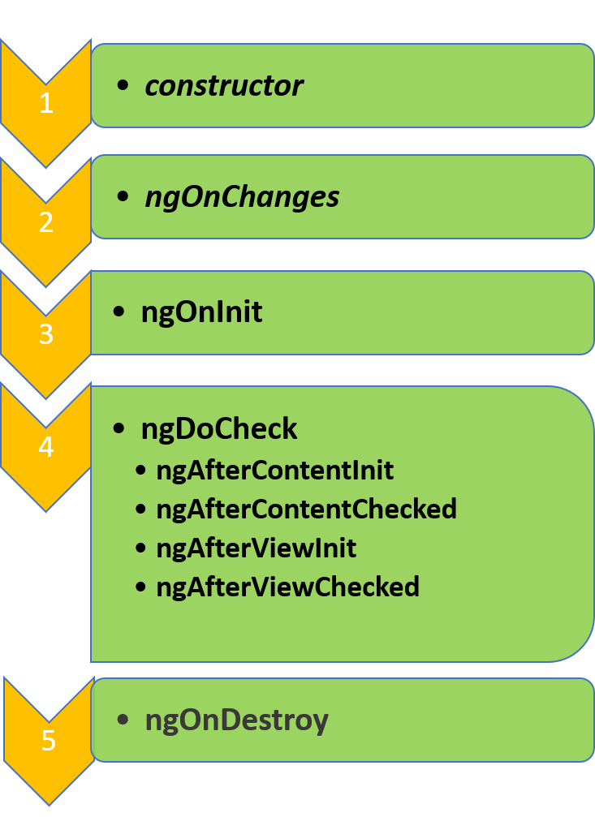
Angular Lifecycle Hooks
Angular
55

Slide 3
Angular Lifecycle Hooks :
Angular
55
ngOnChanges − When the value of a data bound property changes, then this method is called.

Slide 4
Angular Lifecycle Hooks :
Angular
55
ngOnInit − This is called whenever the initialization of the directive/component after Angular first displays the data-bound properties happens.

Slide 5
Angular Lifecycle Hooks :
Angular
55
ngDoCheck − This is for the detection and to act on changes that Angular can't or won't detect on its own.

Slide 6
Angular Lifecycle Hooks :
Angular
55
ngAfterContentInit − This is called in response after Angular projects external content into the component's view

Slide 7
Angular Lifecycle Hooks :
Angular
55
ngAfterContentChecked − This is called in response after Angular checks the content projected into the component.

Slide 8
Angular Lifecycle Hooks :
Angular
55
ngAfterViewInit − This is called in response after Angular initializes the component's views and child views.

Slide 9
Angular Lifecycle Hooks :
Angular
55
ngAfterViewChecked − This is called in response after Angular checks the component's views and child views.

Slide 10
Angular Lifecycle Hooks :
Angular
55
ngOnDestroy − This is the cleanup phase just before Angular destroys the directive/component.

Slide 11
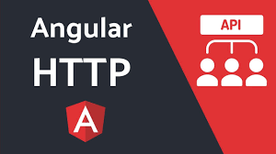
Angular API:
Angular
55

Slide 12
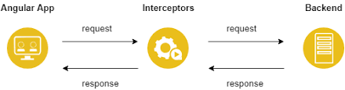
Angular Interceptors:
Angular
55

Slide 13
That’s All For Today Day-8 !!
Questions?

Slide 14
Thank You
shiva1991@live.com

